Slide 1

FOREST FIRE DATA ANALYSIS
SPEAKER: KIRA WONG

Slide 2


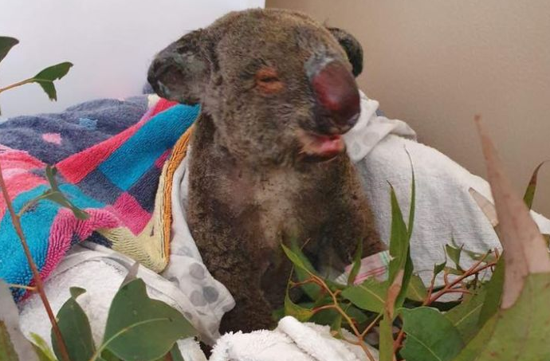
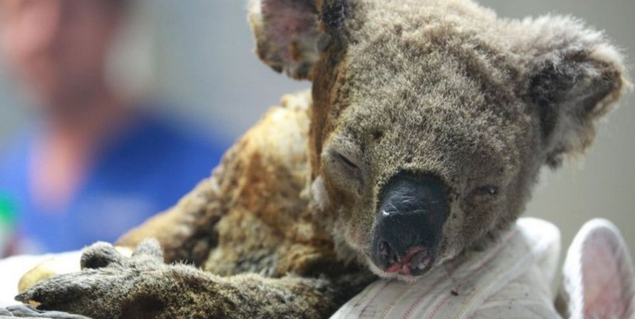
OBJECTIVE
Predict forest fire breakout on given conditions (features)
Forest fires are a serious problem for the preservation of the Tropical Forests and animals
1 billion animals estimated to be dead in Australia 2019 fire

Slide 3






METHODOLOGY
Classification
models
EDA

Slide 4
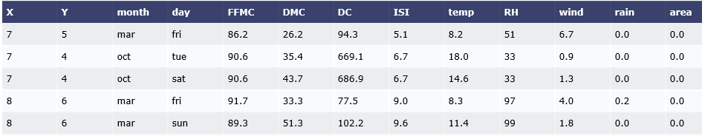

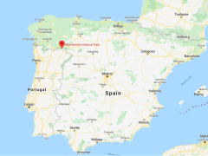
Dataset
Dataset contains info on Montesinho natural park in Portugal
Date, coordinates, index and meteorological data
Notes:
meteorological data such as rain, temperature, humidity, and wind
Fine Fuel Moisture Code (FFMC) - fuel moisture of forest litter fuels under the shade of a forest canopy. represent moisture conditions for shaded litter fuels,
Duff Moisture Code (DMC) - fuel moisture of decomposed organic material underneath forest litter
Drought Code (DC) – moisture of deep soil layer
Initial Spread Index (ISI) - estimate a spread potential by integratin fuel moisture and effect of wind speed
Relative humidity (RH) – moisture in air

Slide 5
FEATURES
Fine Fuel Moisture Code (FFMC) - fuel moisture of forest litter fuels under the shade of a forest canopyDuff Moisture Code (DMC) - fuel moisture of decomposed organic material underneath forest litter
Drought Code (DC) – moisture of deep soil layer
Initial Spread Index (ISI) - estimate a spread potential by integrating fuel moisture and wind speed effect
Relative humidity (RH) – moisture in air
Notes:
meteorological data such as rain, temperature, humidity, and wind
Fine Fuel Moisture Code (FFMC) - fuel moisture of forest litter fuels under the shade of a forest canopy. represent moisture conditions for shaded litter fuels,
Duff Moisture Code (DMC) - fuel moisture of decomposed organic material underneath forest litter
Drought Code (DC) – moisture of deep soil layer
Initial Spread Index (ISI) - estimate a spread potential by integratin fuel moisture and effect of wind speed
Relative humidity (RH) – moisture in air

Slide 6
Modelling
Train-Test-Split ( 80 – 20 )
Parameters tuning for all classification model(s) used
Accuracy used as score since target dataset is balanced
Cross-validated score between all classification models
retrain best model
Score best model against out-sample test set
Notes:
meteorological data such as rain, temperature, humidity, and wind
Fine Fuel Moisture Code (FFMC) - fuel moisture of forest litter fuels under the shade of a forest canopy. represent moisture conditions for shaded litter fuels,
Duff Moisture Code (DMC) - fuel moisture of decomposed organic material underneath forest litter
Drought Code (DC) – moisture of deep soil layer
Initial Spread Index (ISI) - estimate a spread potential by integratin fuel moisture and effect of wind speed
Relative humidity (RH) – moisture in air

Slide 7
CV SCORE COMPARISON
Cross-validated score with 5 classification model:
Model | Best parameter | Accuracy
Naive Bayesian | Bernouli | 0.530
Decision Tree | Max_depth = 4 | 0.534
Logistic Regression | C = 1 | 0.542
Randomforest | Max_depth = 3 n_estimator=700 | 0.572
KNN | n_neighbours = 29 Weights = distance | 0.586

Slide 8
RESULTS
Out-of-sample score with top 2 best model:
Model | Best parameter | Accuracy
KNN | n_neighbours = 29 Weights = distance | 0.567
RF | Max_depth = 3 N_estimator=700 | 0.586

Slide 9
CONCLUSION
INSIGHTS
Randomforest model is the better model for predicting fire outbreak
No fire outbreak on the month of dec

Slide 10
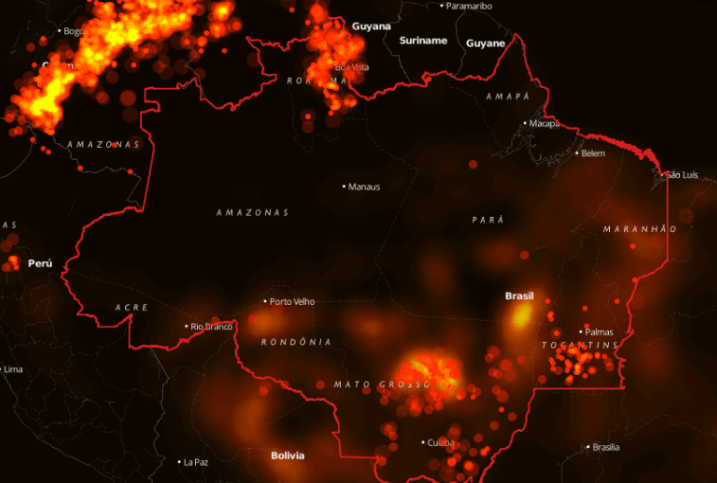

FUTURE WORK
Develop front end content
Incorporate predicting size of burnt area on top of fire outbreak

Slide 11

Thanks!
Any questions?
You can find me at:
Kirawong_datasci@hotmail.com

Slide 13
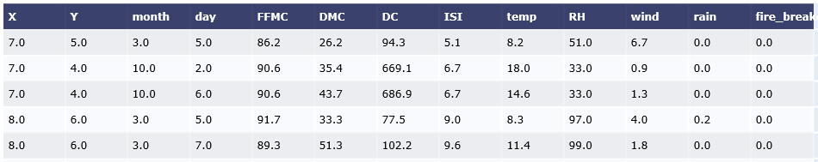

Slide 14
